Slide 1

Chandigarh University
Department of Mathematics
B.Tech. CSE (Core/DS/IT/CC)
Semester-3
Subject Code:25MTT-202
Discrete Mathematics
Unit-2 (Chapter- 2.1.1)
Dr. SARTAJ
DISCOVER . LEARN . EMPOWER

Slide 2

CO mappings

Slide 3

CO-PO mappings
Note: Degree of relevance/correlation: 1-Low, 2-Medium, 3-High, Blank or ‘- ‘- Nil

Slide 4
Topics Overview
Sets, Subsets, Power sets
Conclusions
Video links
References

Slide 5
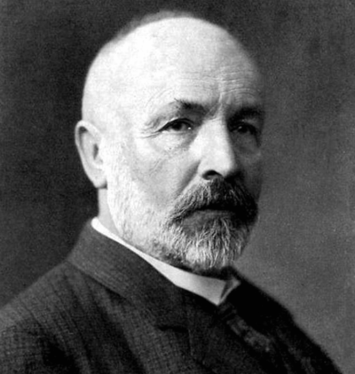
Historical Introduction to Set Theory
Developed by Georg Cantor (1845–1918) Key Concepts:
I. Formal definition of a set
II. Cardinality and different sizes of Finite vs infinite sets
Foundation of modern mathematics and logic
George Cantor ( Source: Wikipedia)
ns

Slide 6
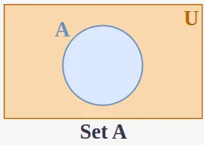
What is a Set ?
Definition: A set is a well-defined collection of distinct objects.
Examples:
Vowels: V = {a, e, i , o, u}
Naturals < 5: N = {1, 2, 3, 4}

Slide 7
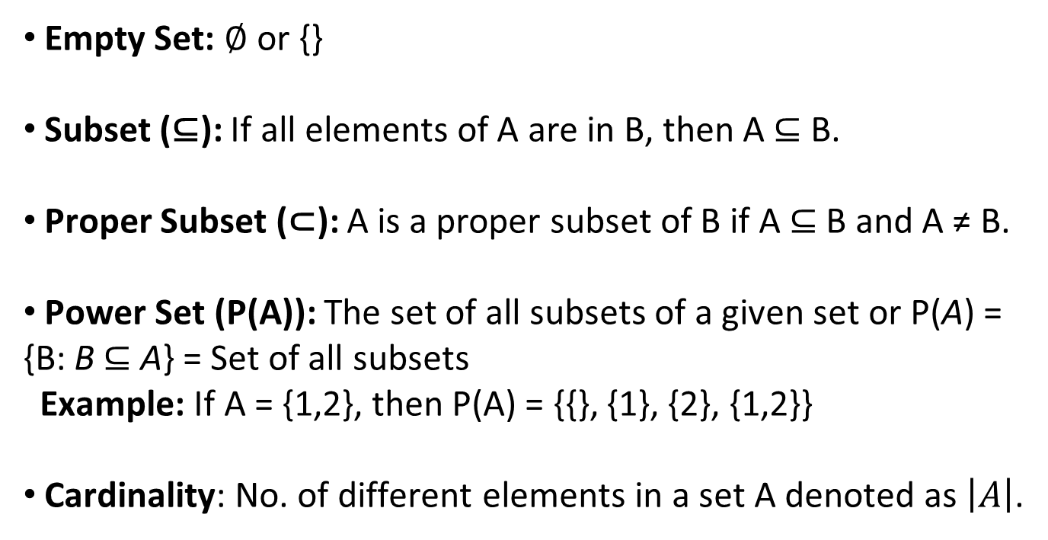
Types of Sets
Empty Set: ∅ or {}
Subset (⊆): If all elements of A are in B, then A ⊆ B.
Proper Subset (⊂): A is a proper subset of B if A ⊆ B and A ≠ B.
Power Set (P(A)): The set of all subsets of a given set or P(A) = {B: B ⊆ A} = Set of all subsets
Example: If A = {1,2}, then P(A) = {{}, {1}, {2}, {1,2}}
Cardinality: No. of different elements in a set A denoted as $\left|A\right|$.
Dr. Shyam Sumanta Das (Department of Unit-1: Basic Set Theory, Logic, and Functio
ns

Slide 8
Types of Sets
Finite/Infinite: If number of elements in a given set is finite/infinite.
Universal Set: Contains all elements under discussion
Complement: A′ = U − A
Dr. Shyam Sumanta Das (Department of Unit-1: Basic Set Theory, Logic, and Functio
ns

Slide 9
Activity-1
1. Find P(A) if A = {2, 3}.
2. Given a set S = {1, 2, 3}, list all its subsets. Also find its power set.
3. Find cardinality of a set A containing n-elements and P(A).

Slide 10
Conclusion
Set theory provides foundation for all mathematics
Types of sets and Venn diagrams are discussed.
In next topic we discuss cartesian product, union and intersection of two sets.
ns

Slide 11
Video Links
https://www.youtube.com/watch?v=zhKu0lQW0a8&list=PLFW6lRTa1g83LYdhDkUQfkXs7EbMBwYuF
https://www.youtube.com/watch?v=zDkD0liU_1g

Slide 12
References
Sr. No. | Author | Name of the Book | Publisher | Year of Publication
1 | Kenneth H. Rosen | Discrete Mathematics and Its Applications | McGraw-Hill | 2019
2 | C. L. Liu | Elements of Discrete Mathematics | McGraw-Hill | 1996
3 | J. P. Tremblay, R. Manohar | Discrete Mathematical Structures with Applications to Computer Science | Tata McGraw Hill | 2001
4 | Kolman, Busby, Ross | Discrete Mathematical Structures | PHI | 2001
5 | Narsingh Deo | Graph Theory with Applications to Engineering and | PHI | 2017

Slide 13
Thanks!!!

